Slide 1
Spark Overview
Notes:
Our Spark overview will cover: Why you should care about Spark, What it is, Why’ there’s so much interest, How it relates to Hadoop and how it performs.

Slide 2
Why Should We Care about Spark?
Spark runs analytics faster on big data
Complex workload complete significantly faster in spark compared to Hadoop Map/Reduce
Spark enables users to be more productive
Users are able to:
Build predictive models faster
Conduct more experiments in less time
Build multiple models without waiting for the system
Notes:
Why should we care about Spark? There are really two key things to remember. First, Spark is going to run analytics faster on big data. That’s because the complex workflows that are typically present in a analytics use case have often times iterative tasks in play. What Spark enables in comparison to Map/Reduce is the ability to utilize and pass data that is cached in memory making it much faster.
Additionally it allows the user to be much more productive in their day to day tasks. Users can build their predictive models faster. Which allows them to iterate more rapidly. And because they can build multiple models concurrently without having to wait for the system, it allows them to conduct more experiments over a shorter period of time thereby enabling them to come to solutions to their analytic use cases faster than ever before.

Slide 3

What is Apache Spark?
Developed in 2009 at UC Berkley AMPLab
Open sourced 2010; top-level Apache project 2014
Since 2009, more than 800 developers from over 200 companies have contributed
Includes multiple libraries that build on the Spark stack
Goal: Generalize MapReduce to support new apps within the same engine
Notes:
By way of background, Spark was developed about 6 years ago at the AMPLab at UC Berkely. The founders are the people who incorporated Databricks which offers a cloud offering of Spark and commercial support for it. The technology for it was open sourced about a year later in 2010 and it became a top-level Apache project very recently in 2014. Since 2009 Spark has had more than 800 developers from over 200 companies contribute to the project. This is another advantage of Spark. The Open Source world allows for many people with varying degrees of skill and knowledge to contribute and improve the technology.
There are multiple libraries that are included in Spark that allow for programmers to use the same abstraction layer. This also makes it much more efficient because they are reusing code, reusing skills and really the goal of this technology was to generalize the old MapReduce model so that new applications can be supported within the same engine.
As you see in the diagram here, fundamentally the Spark Core API allows for programmers to interact with it via different programming languages such as R, Python, SCALA, Java, and so on. And on top of that API, is a set of libraries that provide different kinds of capabilities. The SQL, the Streaming Technologies, Spark MLib, which is the machine learning library. As well as Graph Computation with GraphX.
So what this provides is a very broad set of capabilites that allow organizations to extend on top of them.

Slide 4
Key Reasons for Interest in Spark
Performance / Scalability
Resilient Distributed Dataset (RDD)
Optional In-Memory cache across cluster
Great for iterative algorithms
A simple and intuitive API for programmers in their language of choice
R, Python, Scala, Java
Integration with existing Big Data infrastructure
Hadoop HDFS data
Kafka – Internet-scale publish / subscribe messaging (i.e. MQ for the internet)
Open source big data predictive analytics
UC Berkley & others are building out a library of big data predictive analytics
Notes:
Let’s talk a little bit more about why Spark is generating so much interest in the world. Probably the biggest reason is that it outperforms older solutions and it scales horizontally. Part of the reason that its able to do this is because of a notion called Resilient Distributed Dataset or RDD. You can think of this as a way for Spark to cache data in memory across the cluster which allows for chained operations or any kind of iterative operations to very quickly operate on the data without having to incur the overhead of reading and writing the data to and from the disk . This makes It much more efficient and perform more rapidly than the old Map/Reduce model.
Furthermore, because it abstracts this core for the programmers, it provides a much easier environment for them to program too. There is a very simple and intuitve API that a programmer can interact with and they can use their favorite language to do so. And as I pointed out before there are several common programming languages including Python which is what we’ve been using, that they can leverage for programming and utilizing Spark.
It integrates very well with existing big data infrastructures. In particular it integrates very well with Hadoop and the hadoop distributed file system. It also provides support for various other services including things lke Kafka which is a internet-scale messaging mechanism.
It is an Open source big data predicative analytics infrastructure and there are many many organizations that are contributing to it and building out these libraries of big data predicitve analytics . Many of them, in fact most all of them, are speciallized for conducting analytics over very deep and very wide data that is typically what you find in the Hadoop infrastructure.
Therefore, Spark is very popular and holds a lot of benefits for people who are conducting analytics in those kinds of environments.

Slide 5
Spark’s Relationship to Hadoop
Complementary functionality
Spark does not have a native data storage system
Spark with Hadoop HDFS is a great combination, but Spark can also analyze data outside of HDFS
Great synergy with Spark
Alternative infrastructure options (YARN)
Spark can use YARN to run on the same nodes in Hadoop as the data being analyzed in HDFS
By using YARN for Spark, the administrator can control how much resource Spark users get versus other workloads running in Hadoop YARN
Spark can optionally run on other infrastructures (Mesos, etc.)
Competing functionality
Spark competes against Hadoop Map/Reduce
Notes:
It’s important to undestand the relationshop between Spark and Hadoop as there is a lot of misunderstanding here. First and foremost, Spark is not a c ompetitor to Hadoop furthermore, spark does not require hadoop. Now there are different degrees of relationship between spark and hadoop. On the one hand, they are very complimentary with one another. Spark by iteself does not have a native storage system and therefore it integrates very well with the Hadoop and the Hadoop HDFS storage system.
Spark is a great combination with Hadoop HDFS but it can also be utilized with data that is not stored in HDFS using other kinds of storage mechanisms. So from this perspecitve there is a great synergy with Spark.
Spark also offers alternatives to things that are available in hadoop. For example, Spark is able to use yarn to run on the same nodes in Hadoop as the data that’s being analyzed. So it can use Yarn as a resource manager and by doing this it allows the administrator to control how much resources Spark users will get versus the other workloads that are running in their hadoop environment. So it provides this easy and discretely environment to manage workload. However there also other infrastructures that Spark can run other than Yarn.
Now there is one are that Spark does compete directly with Hadoop and that is the area of Spark versus Map/Reduce. Spark is a competing technology to Haddop Map/Reduce and it is an either or selection.

Slide 6
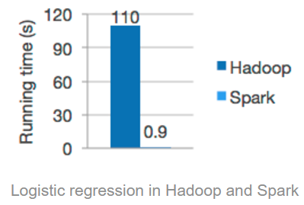
A Word about Spark Performance
Theoretical 100x performance versus Map/Reduce
What to expect in the real world
Complex workloads where data fits in memory: up to 10x – 15X improvement
Complex workloads where data does not fit in memory: up to 2x improvement
Simple operations, regardless of data fit: Up to 2x improvment
Notes:
Now it’s important to also have a level set with respect to Spark performance. Anyone who’s been paying attention has heard a lot of great claims about Spark performance and in particular that Spark is 100 times faster than Map/Reduce. And this is true under very specialized conditions under a very specialized test case. It’s important to relate performance back to real world though and what are data scientist going to be doing in their organizations and what can they expect to see.
Now the reality is that when you are running a complex workload where the data fits in memory, you can expect from a 10 to 15 times improvement utilizing Spark over map/reduce. And the factors that are going to influence this performance are pretty straight forward.
First if you have a complex workload, where you are going to be iterating over the same set of data multiple times, spark is going to be faster because the data is held in memory and the data and these operations occur without having to read and write the data fro storage.
Similarly if there are several operations that are chained together into a single job this is going to be faster because it’s going to avoid the job steps reading and writing to storage in between each of them. So this ability to pass data in memory from one step to another is part of what speeds up the operation.
When we have a complex workload where the data does not fit in memory, we should see about a 2x improvement in performance in most cases. Part of the reason for this improvement is that Spark will be more efficient at file i/o than map/reduce is. Additionally when you multiple job steps chained together some of them may output a smaller amount of data that Spark can pass to the next job step in memory and avoid the i/o overhead.
Finally a simple operation, regardless of whether the data fits into memory or not is going to be about a 2x improvement as well and this really refers to simple operations that are completed in one scan of the data. A factor that really helps Spark excel is when an operation needs to iterate over data, That’s where the best performance gains are going to be because they can do those operations while holding the data in memory.

Slide 7

Who is using it? How is the market share?
300+ Production Deployments Across Industries
http://go.databricks.com/hubfs/pdfs/Databricks_Primer_170303.pdf

Slide 8
Spark Components
Notes:
Our Spark overview will cover: Why you should care about Spark, What it is, Why’ there’s so much interest, How it relates to Hadoop and how it performs.

Slide 9
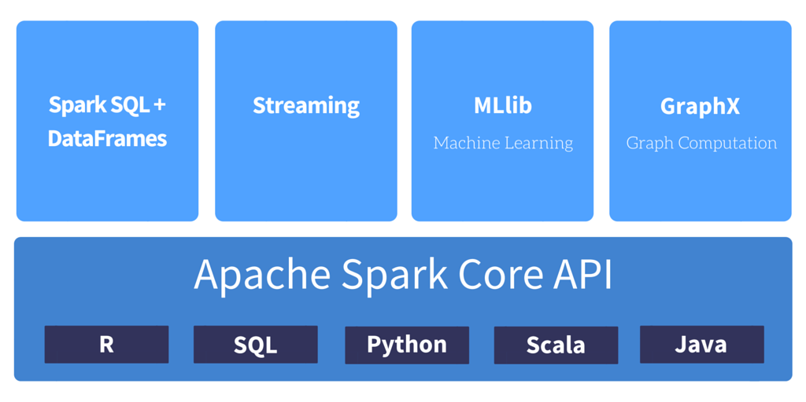
Spark Core
Basic functionality: task scheduling, memory management, fault recovery, interacting with storage systems and more.
Provides the API for resilient distributed datasets (RDDs)

Slide 10
Spark SQL
Seamlessly mix SQL queries
SQL or a DataFrame API. Usable in Java, Scala, Python and R.
Uniform Data Access
Hive, Avro, Parquet, ORC, JSON, JDBC, and etc
Hive Compatibility
Connect through JDBC or ODBC
Notes:
https://spark.apache.org/sql/

Slide 11
Spark Streaming
Ease of Use
letting you write streaming jobs the same way you write batch jobs
Fault Tolerance
Spark Streaming recovers both lost work and operator state (e.g. sliding windows) out of the box, without any extra code on your part.
Spark Integration
Combine streaming with batch and interactive queries.

Slide 12
Spark MLib
Ease of Use
Usable in Java, Scala, Python, and R.
Performance
High-quality algorithms, 100x faster than MapReduce.
Easy to Deploy
Runs on existing Hadoop clusters and data.

Slide 13
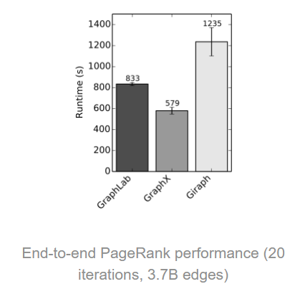
GraphX
Flexibility
Seamlessly work with both graphs and collections.
Speed
Comparable performance to the fastest specialized graph processing systems.

Slide 14
Cluster Managers
Standalone – a simple cluster manager included with Spark that makes it easy to set up a cluster.
Apache Mesos – a general cluster manager that can also run Hadoop MapReduce and service applications.
Hadoop YARN – the resource manager in Hadoop 2.

Slide 15
How to Start?

Slide 16


Workspaces allows you to save notebooks and libraries and share them with other users.
Notebooks are a set of any number of cells that allow you to execute commands.
Dashboards can be created from notebooks as a way of displaying the output of cells without the code that generates them.
Libraries are packages or modules that provide additional functionality that you need to solve your business problems. These may be custom written Scala or Java jars; python eggs or custom written packages.
Clusters are groups of computers that you treat as a single computer. In Databricks, this means that you can effectively treat 20 computers as you might treat one computer.
Jobs are the tool by which you can schedule execution to occur either on an already existing cluster or a cluster of its own. These can be notebooks as well as jars or python scripts. They can be created either manually or via the REST API.
Apps are third party integrations with the Databricks platform. These include applications like Tableau.

Slide 17
Help Resources
The Databricks Guide
Sample code/ tutorials
The Spark APIs
The Apache Spark Documentation
Databricks Forums
https://forums.databricks.com/

Slide 18
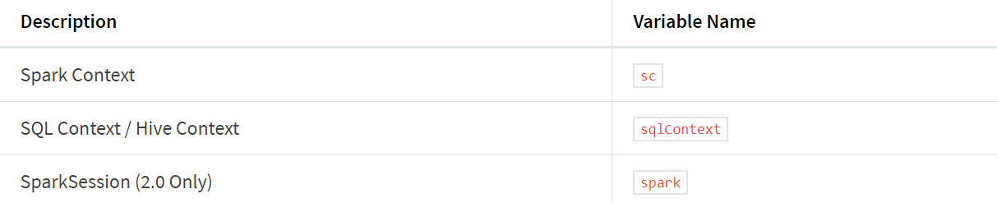
The Contexts/ Environments
The sqlContext makes a lot of DataFrame functionality available.
The sparkContext focuses more on the Apache Spark engine itself.
However in Apache Spark 2.X, there is just one context - the SparkSession.

Slide 19
Data Interfaces
The RDD (Resilient Distributed Dataset)
It is an interface to a sequence of data objects that consist of one or more types that are located across a variety of machines in a cluster
The DataFrame
The DataFrame is a collection of distributed Row types. These provide a flexible interface and are similar in concept to the DataFrames you may be familiar with in python (pandas) as well as in the R language.
The Dataset
It provides the typed interface that is available in RDDs while providing a lot of the conveniences of DataFrames. It will be the core abstraction going forward.

Slide 20
Getting Started
Go to https://databricks.com/
Create a community account
Create a Cluster
Create a Notebook
Type command/code start with below:
%scala for scala
%sql for sql
%r for r
%python for python
%md for markdown

Slide 21
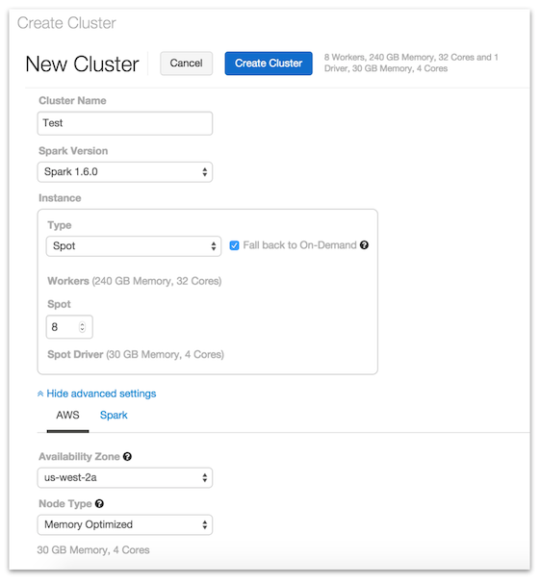
Creating a Cluster
Select a unique name for the cluster.
Select the Spark Version.
Enter the number of workers to bring up - at least 1 is required to run Spark commands.
Select whether to use On-Demand Instances, Spot Instances, or a combination of both.

Slide 22
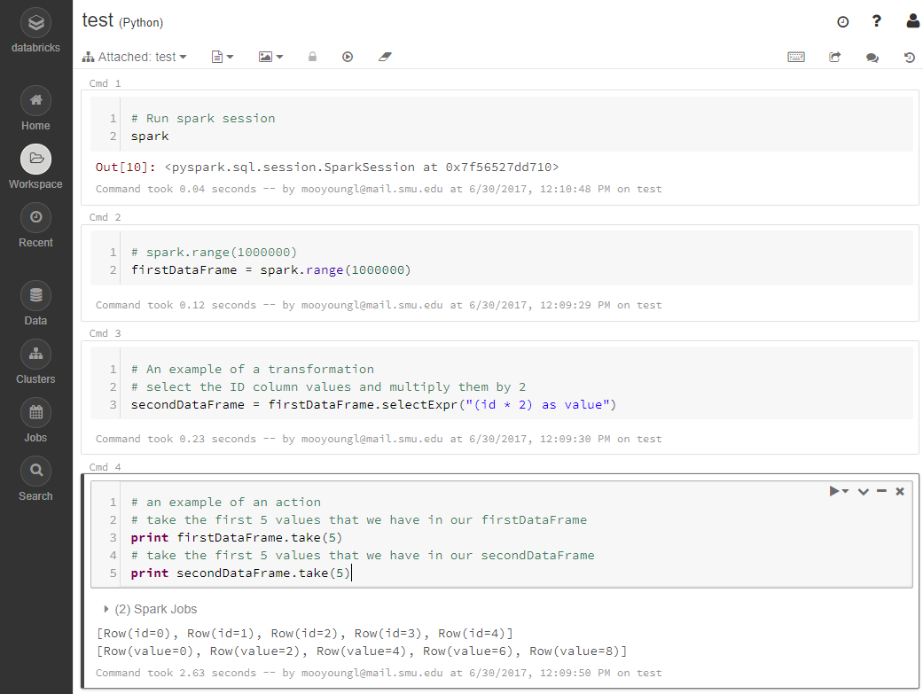

Slide 23
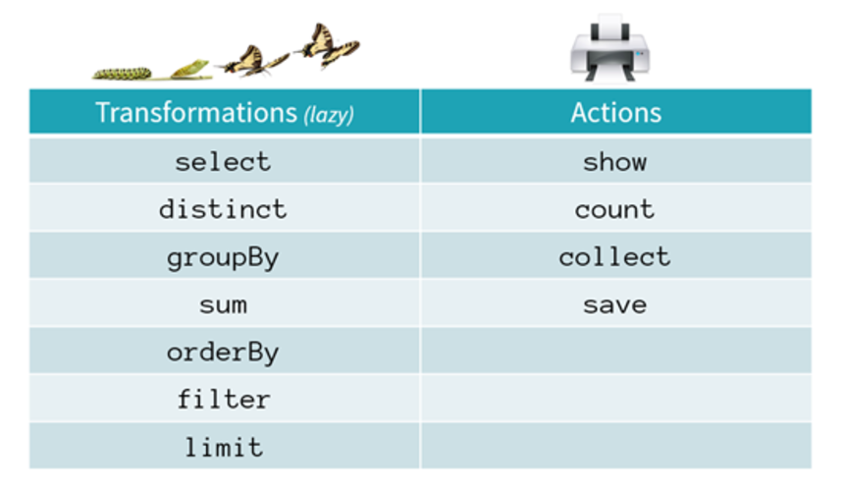
Transformation vs Action commends
The reason for the lazy operation is that it gives a simple way to optimize the entire pipeline of computations as opposed to the individual pieces.
Apache Spark can also keep results in memory as opposed to other frameworks that immediately write to disk after each task.

Slide 24
Spark for Data Scientist

Slide 25
Python Example: Install Packages

Slide 26
Regression - MLlib
8-SparkML (Python)
https://www.lynda.com/Hadoop-tutorials/Spark-ML-Building-model/516574/593206-4.html?srchtrk=index%3a1%0alinktypeid%3a2%0aq%3aExtending+Hadoop+for+Data+Science.%0apage%3a1%0as%3arelevance%0asa%3atrue%0aproducttypeid%3a2

Slide 27
Advanced Machine Learning
9-Use-MxNET (Python)
10a-TF-setup-community (Python) / 10b-TF-setup-pro (Python)
11-Use-TF (Python)

Slide 28
Streaming
12-Streaming (Python)
https://www.lynda.com/Hadoop-tutorials/Spark-streaming/516574/593214-4.html?srchtrk=index%3a1%0alinktypeid%3a2%0aq%3aExtending+Hadoop+for+Data+Science.%0apage%3a1%0as%3arelevance%0asa%3atrue%0aproducttypeid%3a2

Slide 29
Dashboard

Slide 30
Schedule Job
https://spark.apache.org/docs/latest/job-scheduling.html

Slide 31
Conclusion

